Slide 1
Fertility Rate Influencers in the us
October 28th, 2020
Team 5: Devin Bankston, Isaac Martinez, Jeremy Jackson, Natalie Aviles, Vanessa Lee, Yan Kong

Slide 2
Why did we choose this topic?
Plentiful data available from reliable sources
Not all members realized that fertility rates are declining in the US
Interesting enough for further analysis

Slide 3
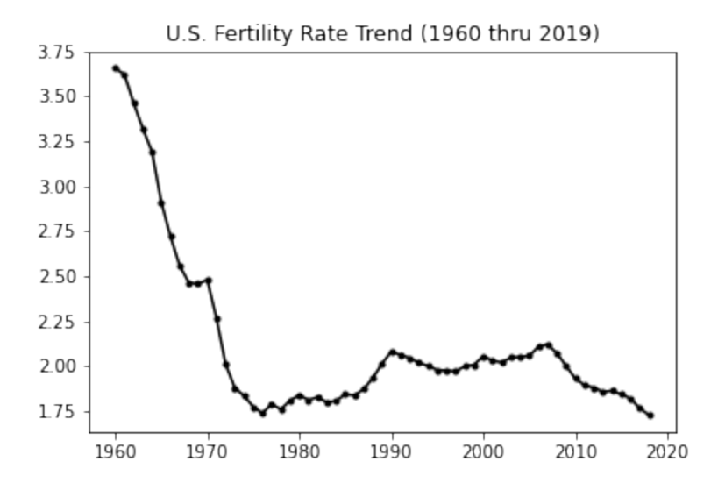
The U.S. fertility rate has decreased over time…

Slide 4
How is Fertility Rate defined?
Fertility rate is the average number of babies born to females during their reproductive years.
For our studies we will define Reproductive Years as the age range 15-49.

Slide 5
We believed the following factors contributed to the decline…
Living Arrangements
Education*
Age*
Marital Status
* Specific to female population only

Slide 6
Our approach…
Collected Data from various resources
Cleansed Data for analysis
For each factor:
Defined our population
Proposed a question
Formed our conclusion
Performed a Retrospective

Slide 7
Cleanup Process Experience
Our data was available for download thru the respective resources but not all in the same format…(ex. .xls vs .csv)
Issues experienced from .csv files that were converted from .xls:
Commas
Rows above header rows that made csv files unreadable by jupyter notebooks
Data not available for all years originally scoped – we kept reducing our time range to accommodate
Unique key was not named consistently across files which required modification in Jupyter notebook (ex. Years, year, YEAR, etc…)
Required conversion of object data types to float data types in Jupyter notebook

Slide 8
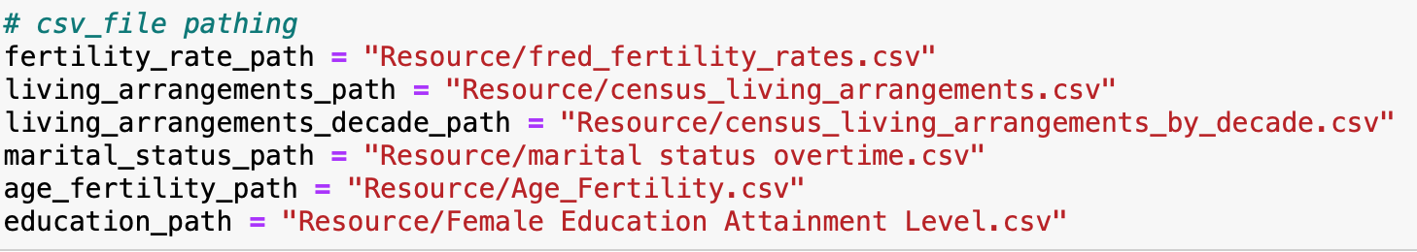
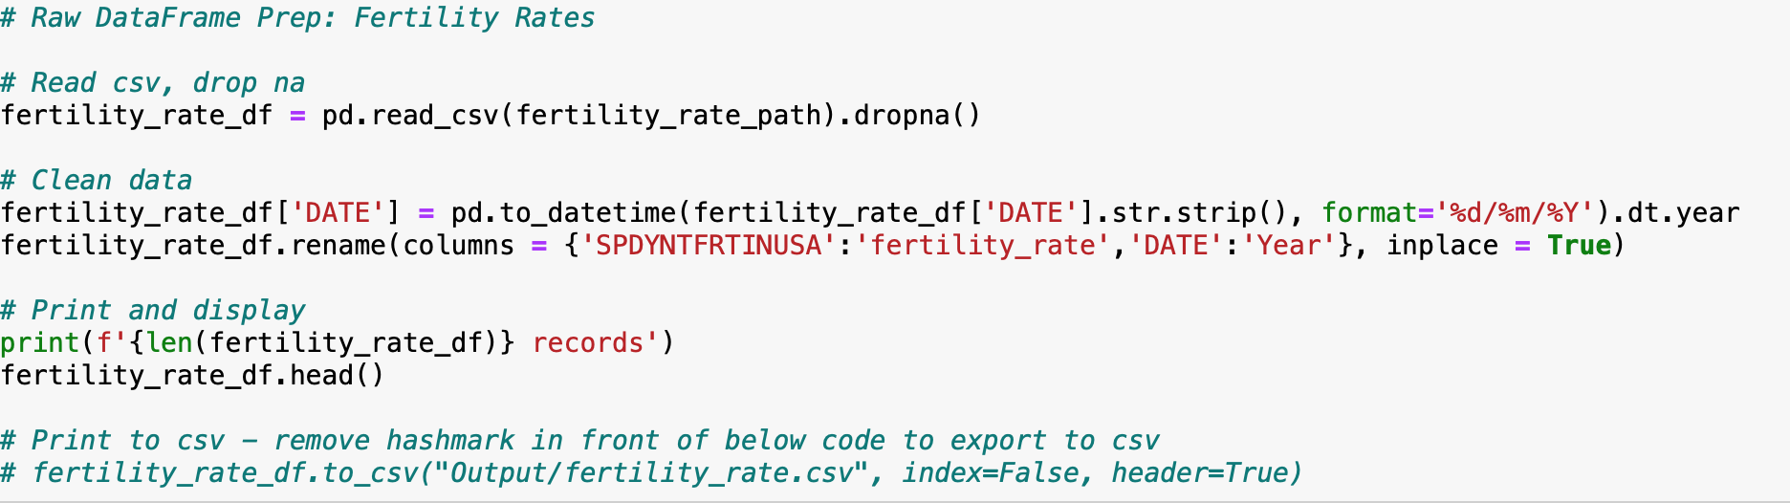
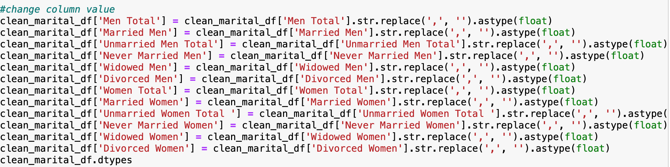

Clean up (con’t)

Slide 9
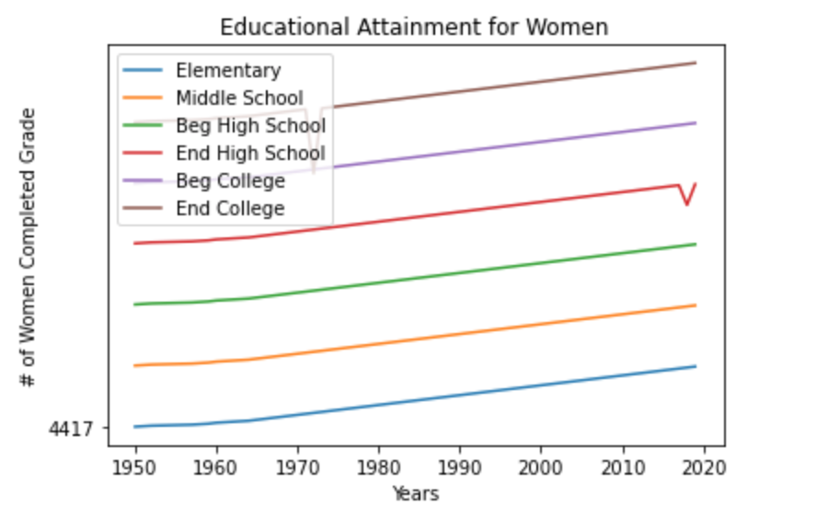
Fertility Rate and Educational Attainment
Through the research the following data shows that female education has increased throughout the years in every grade. As of now, women are the most educated they have ever been but are having fewer children.

Slide 10
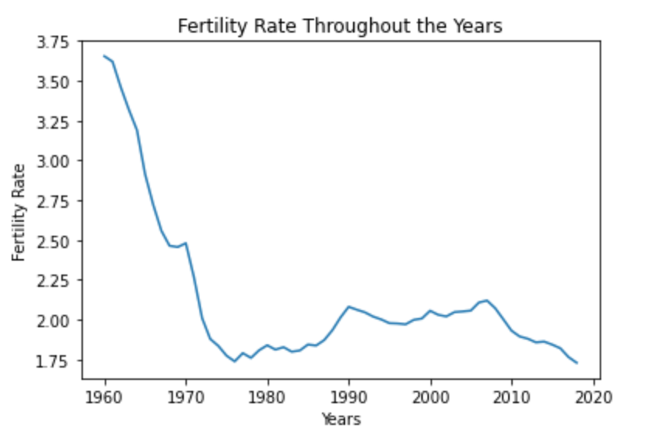
The two charts above show the correlation between education and fertility. Women had the most babies when they were the most uneducated. As opposed to now, female education is at an all time high and is even surpassing men. One can assume that women are having less children since they are using their education in the workforce. More women in the workforce will result in less time dedicated to raising children like they did decades ago.

Slide 11
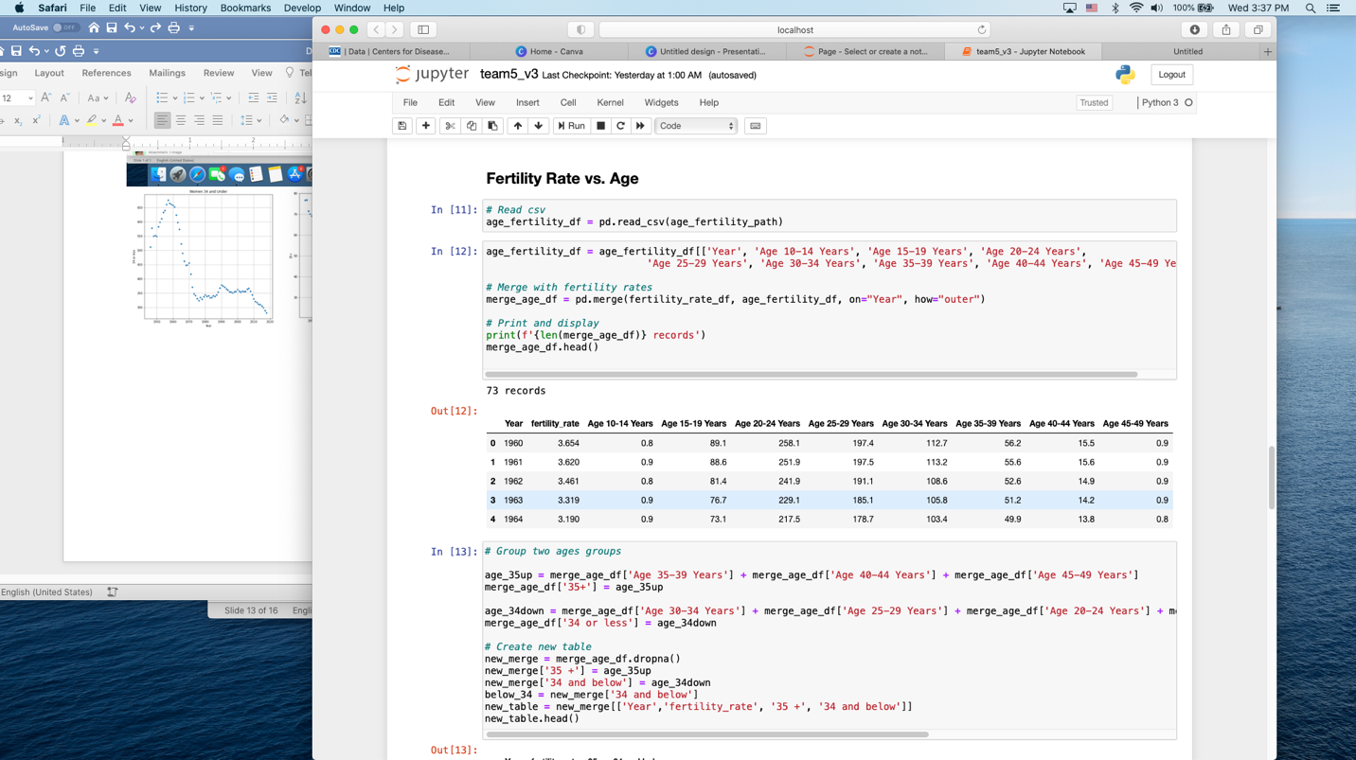
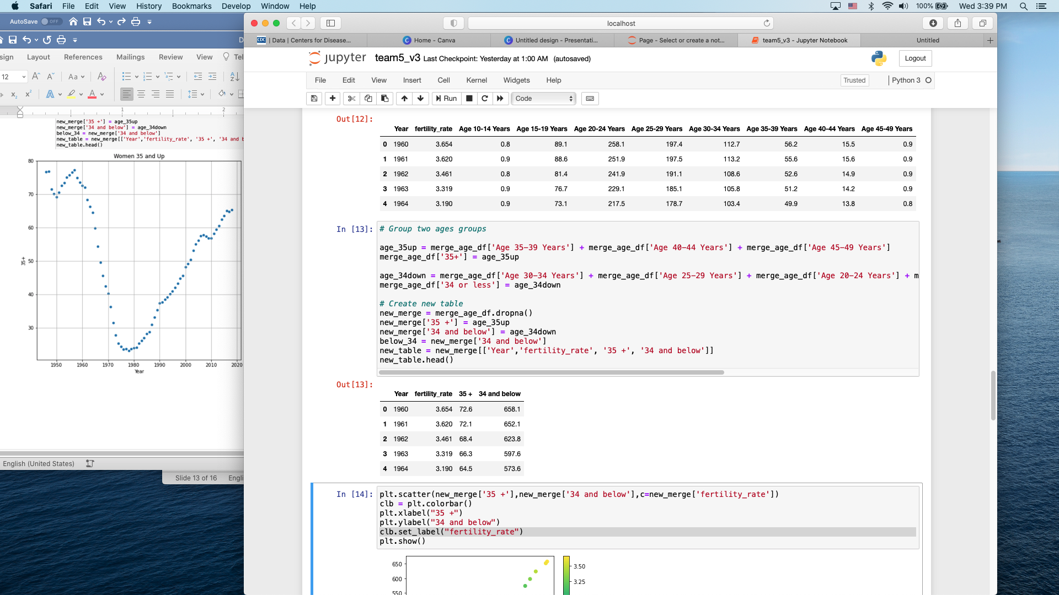
Age
Does a women's age affect fertility rates?

Slide 12
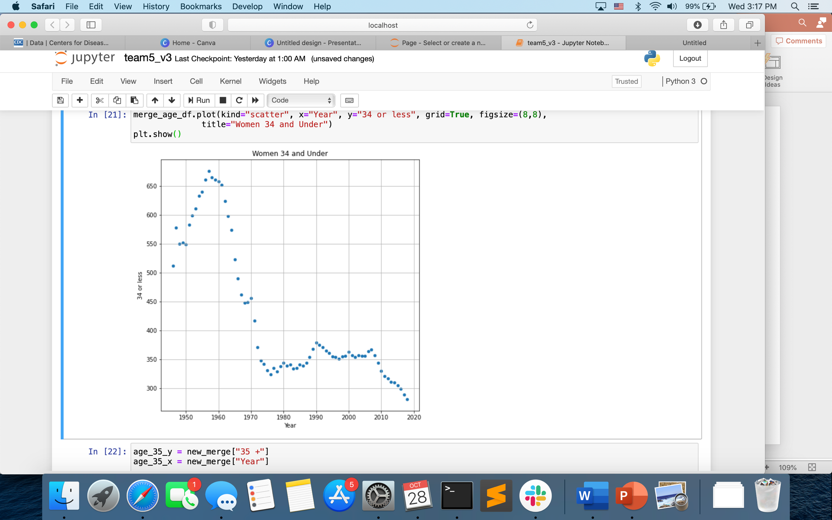
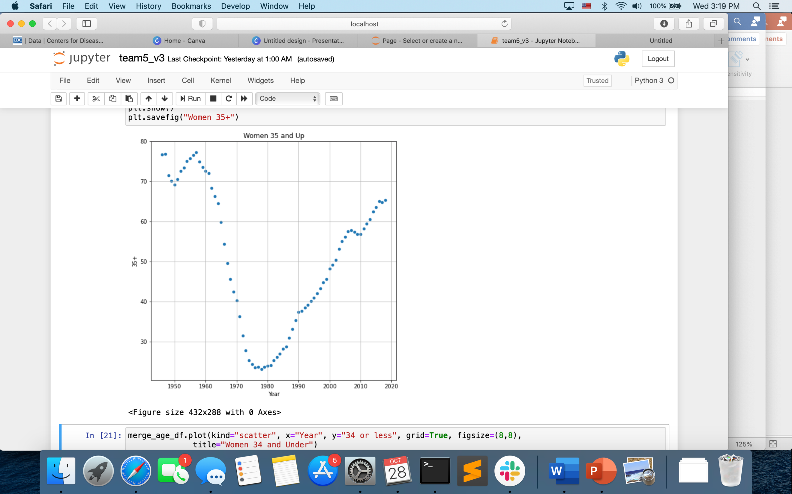
Age
We were surprised to find that the fertility rate of women 35 and older in increasing. We attribute this increase to higher education and possibly healthcare advancements

Slide 13
Marital Status
Null Hypothesis: The fertility rate gets no impact from marital status
Alternative Hypothesis: When the fertility rate decrease, the married people will be less

Slide 14
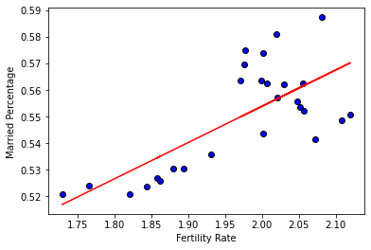
Marital Status
Correlation Coefficient: 0.72
This suggest somehow strong correlations
T test: p value=0.002
Conclusion: Reject the Null Hypothesis
Accept the Alternative Hypothesis

Slide 15
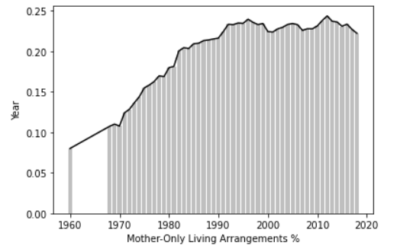
Living Arrangements
This chart shows the % of Children Under Age 18 Living with their Mother Only
Is there a correlation between this and the Fertility Rate?

Slide 16
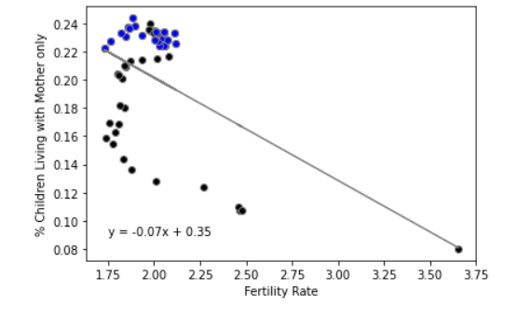
Living Arrangements: Our Tests
Null Hypothesis: If mother-only living arrangements increase over 2 decades, then fertility rates should decrease during that time period.
Alternative Hypothesis: If mother-only living arrangements increase over 2 decades, then the fertility rate might increase or not be affected.
Correlation Coefficient: -0.17
This suggests a weak correlation
Hypothesis Testing: Single Sample T-Test
Subset of Population (Past 2 decades)
Represented in BLUE
P-Value = 9.244269763354844e-16
Supports the ALTERNATIVE HYPOTHESIS!
Conclusion: Reject the Null Hypothesis
Acceptance the Alternative Hypothesis

Slide 17
In conclusion….
Age: Fertility rates for women age 35+ are increasing.
Education: Fertility rates for women with higher education are decreasing.
Marital Status: Fertility rates are decreasing because there are less people getting married.
Living Arrangements: There is no correlation between mother only living arrangements and fertility rates.

Slide 18
Retrospect: Coulda, woulda, shoulda…
If we had more time, we could have used an API.
We could have narrowed down our topics to be more specific.
As a group, a major challenge we faced was Github pushing and pulling. We should have spent more time up front learning how to push and pull information properly.

Slide 19
Questions?

